Slide 1
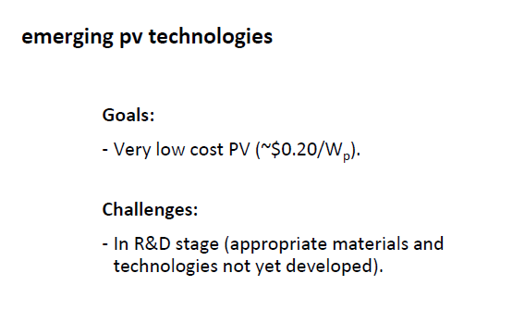

Slide 2
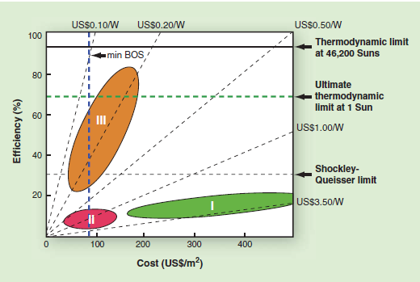

Slide 6
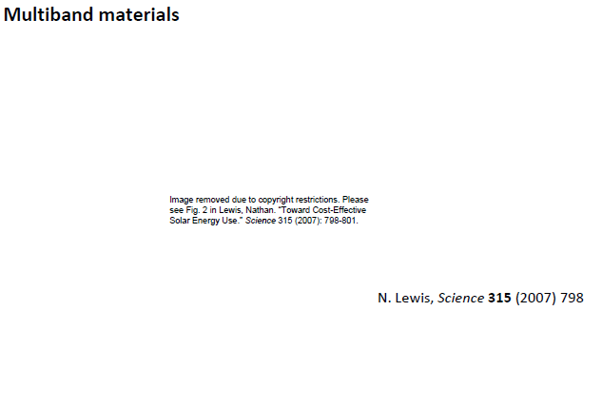
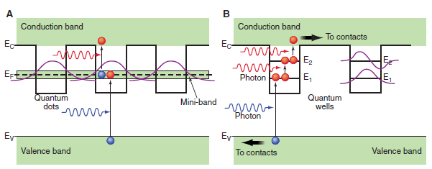
Possible methods of circumventing the 31% efficiency limit for thermalized carriers in a single–band gap absorption threshold solar quantum conversion system.
Intermediate-band solar cell
(B) quantum-well solar cell

Slide 7
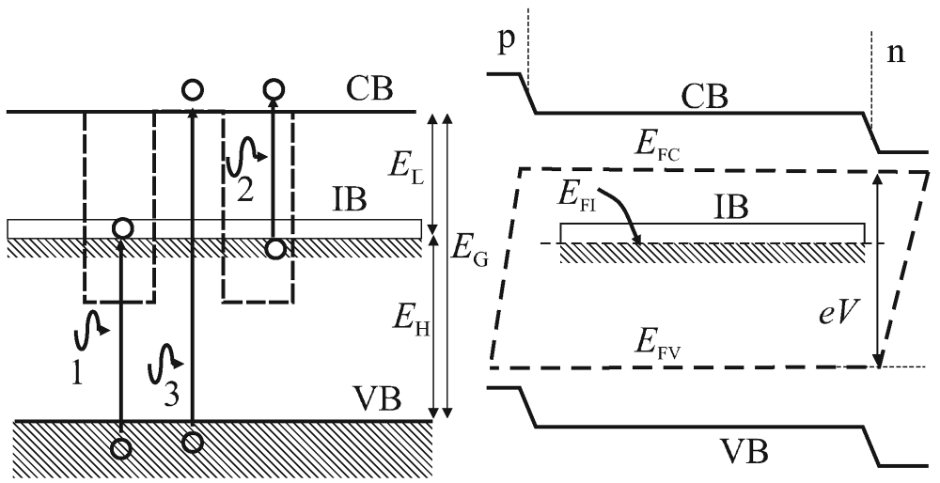
The improvement in efficiency of the cell arises from its potential
(i) to absorb below bandgap energy photons and thus produce additional photocurrent
(ii) to inject this enhanced photocurrent without degrading its output photo-voltage

Slide 8
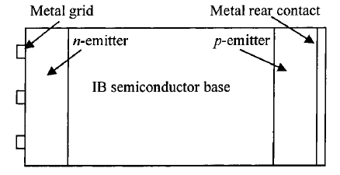
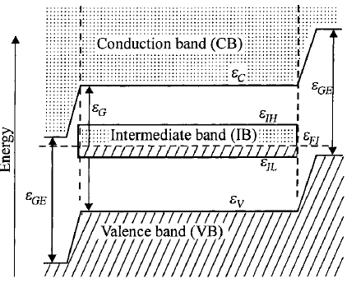
Intermediate band (IB) solar cell
Sketch of an intermediate band (IB) solar cell (top) and energy band diagram in thermal equilibrium showing the energy band extremes vs. the depth into the cell (bottom).
Dashed and dotted regions correspond to electron-filled and empty bands respectively (at 0 K)
Role of the two emitters: prevent the IB from contacting the metallic terminals due to metallic character of IB.
IB can be formed by lone pair bands, low dimensionality superlattices, impurities, etc.

Slide 9
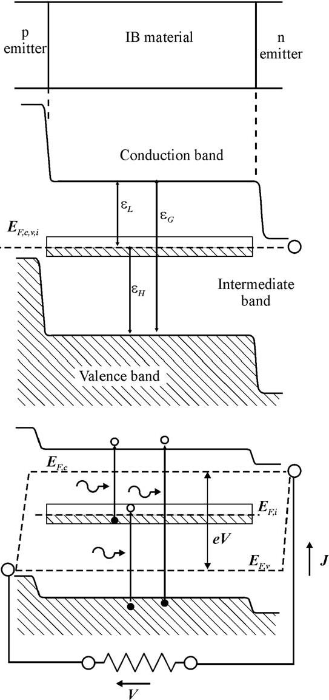
IB is partially filled with electrons --- implies that the Fermi level crosses it.
Under illumination, electrons in the CB are extracted through the n-emitter and holes through the p-emitter.
No carriers are extracted from the IB and hence no transport
(Carriers with high mobility in the IB are not, essential in an ideal device characterized by uniform carrier generation in its bulk [IEEE Trans. Electron Devices 49 (9) (2002) 1632.])
Carrier population in each band is assumed to be governed by quasi-Fermi levels of emitters
The output voltage is determined by the quasi-Fermi level split between the conduction and valence band at the emitter
Output voltage is limited by the total bandgap (ε_{G})
A. Martı´ et al. / Thin Solid Films 511 – 512 (2006) 638– 644

Slide 10
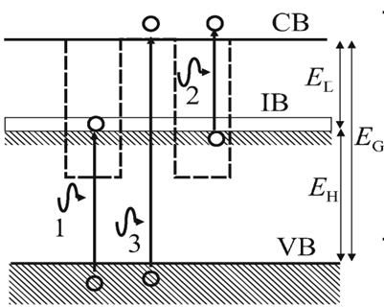
Efficiency of IB Solar Cells
Limiting efficiency under maximum solar concentration (46,050 suns)
Type | IB Solar Cell | Single gap SC | Tandem of two SC
Efficiency | 63.2% | 40.7% | 55.4%
Optimum gap for IB PV Cell
E_{H} = 1.24 eV
E_{L} = 0.71 eV
A. Martı´ et al. / Thin Solid Films 511 – 512 (2006) 638– 644

Slide 11
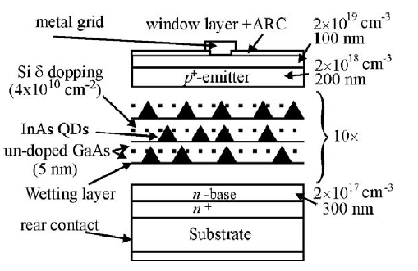
Grown by molecular beam epitaxy (MBE) using the Stranski–Krastanov growth mode.
The barrier and QD materials are GaAs and InAs, respectively.
A silicon delta- (δ-) doped layer, with an areal density approximately to equal the QD density (4x10¹⁰ cm⁻²) is inserted between each QD layer
Confined states are half-filled with electrons via modulation doping.
A. Martı´ et al. / Thin Solid Films 511 – 512 (2006) 638– 644

Slide 12
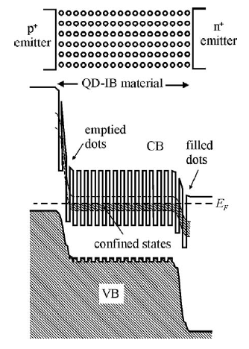
Quantum Dot Intermediate Band Solar Cell (QD-IBSC)
IB arises from the confined electron states in an array of quantum dots.
Energy states located within the forbidden bandgap of a conventional semiconductor.
These intermediate levels must behave only as radiative recombination centers.
A. Martı´ et al. / Thin Solid Films 511 – 512 (2006) 638– 644

Slide 13
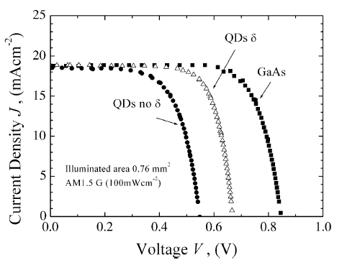
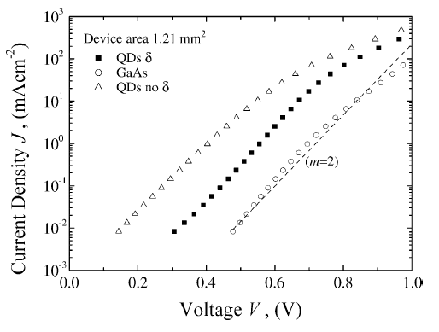
Performance of QD IB Solar Cell
Illuminated
Dark
A. Martı´ et al. / Thin Solid Films 511 – 512 (2006) 638– 644

Slide 14
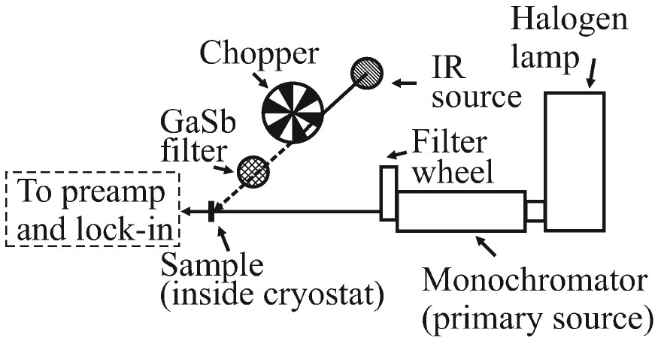
Intermediate transitions in IB Solar Cell
QD-IBSC sample inside a closed cycle He cryostat
Two optical windows
Halogen lamp – primary light source (filtered by an appropriate set of filters to remove secondary wavelengths)
Primary supplies continuous photons (pumping of electrons from the VB to the IB.)
Role of IR source - illuminate the QD-IBSC with photons of energy below the GaSb bandgap (0.726 eV) → IB to CB
Photocurrent is collected through a low noise and low input impedance current-voltage preamplifier
A. Marti, PRL 97, 247701 (2006)

Slide 15
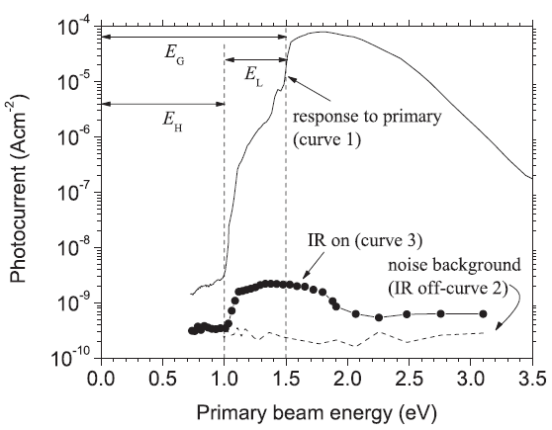
Intermediate transitions in IB Solar Cell
Curve 1 (response to primary):
photocurrent produced when pumping with the chopped primary source only (V=1.5 V, T =4.2 K).
Curve 2 (noise background):
photocurrent measured when the IR source is off while the chopper, located in front the of the IR source, is kept spinning (V=0 V, T = 36 K).
Curve 3 (IR on) :
photo-generated current when the IR source is turned on and chopped (V =0 V,
T =36 K).

Slide 17
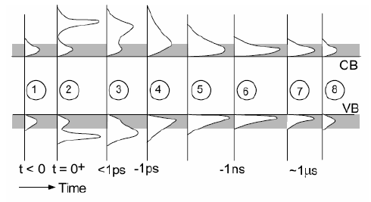
Hot carrier cells:
, 2) Photogeneration
Collisions and smearing of dist.
Broadening and Thermal equilibrium (Boltzmann Dist.)
Carrier-carrier collisions (uniform dist. of excess energy)
Energy loss by phonon emission (high energy optical and acoustic phonons)
Recombination of electron hole pairs
Loss of excess energy and relaxation to equilibrium states

Slide 18
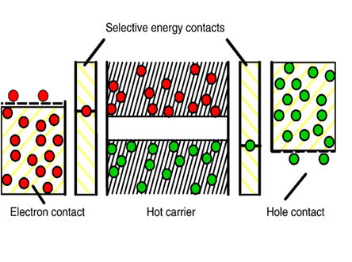
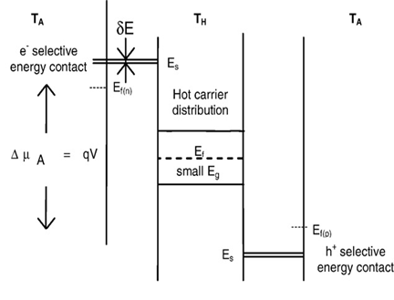
Hot carrier generation
Generation of electron-hole pairs by photons and carrier multiplication by impact ionization
Presence of carrier-carrier scattering and Auger-recombination
Sum of electro-chemical potentials μ_{eh}= 0.

Slide 19
Why do we need a membrane layer?
Isentropic cooling
A hot electron distribution with temperature T_{eh} is only stable, as long as there is no interaction of electrons and holes with phonons.
In the electrodes the interaction with phonons cannot be avoided
Leads to thermalisation from the high carrier temperature T_{eh} to the lattice temperature T_{o}
Results in generation of entropy.
Entropy transfers heat to lattice (no longer available for carrier multiplication)

Slide 20
Isentropic cooling
Avoid energy losses by maintaining carriers with same energy at constant carrier concentrations.
Possible with a narrow band of width dε << kT_{o}
Membrane layer offers states for electrons/holes only in a small energy interval at ε_{e}
Typically a large bandgap, small bandwidth material
Cooling, proceeds at constant energy and constant electron concentration and thus at constant entropy in a reversible process.

Slide 21
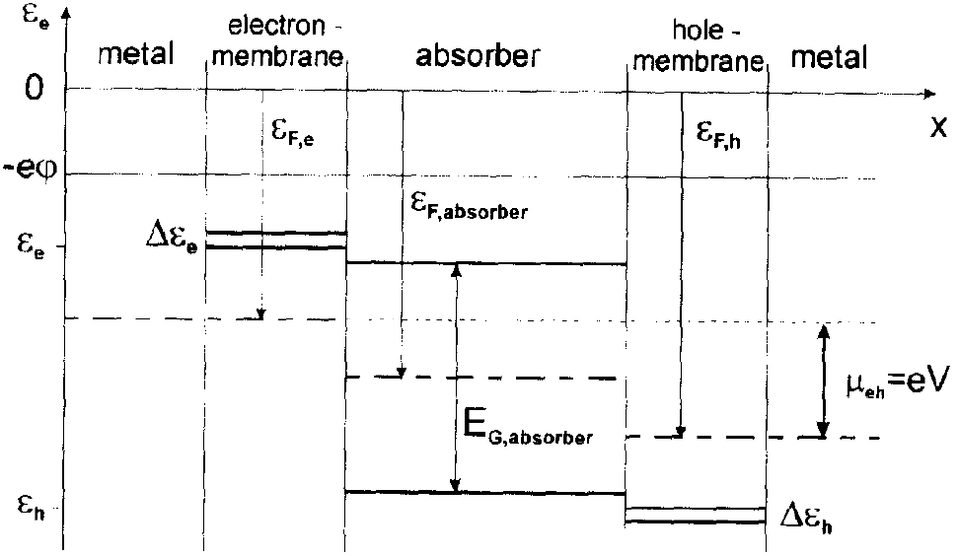
Band diagram of hot carrier cell
ε_{e} - Electron energy Δε_{e} - band width in CB ε_{F,e} - Fermi level in electron membrane
ε_{h} - Hole energy Δε_{h} - band width in VB ε_{F,h} - Fermi level in hole membrane

Slide 22
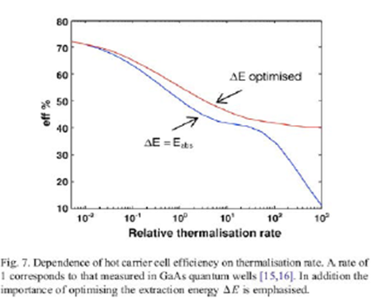
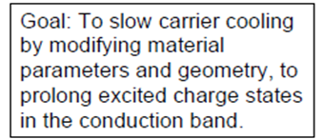

Slide 23
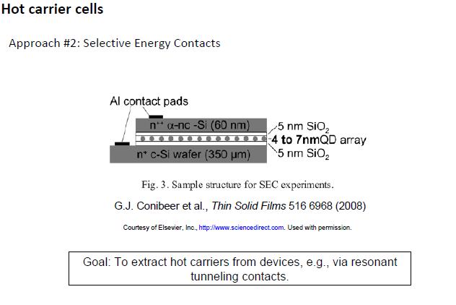

Slide 24
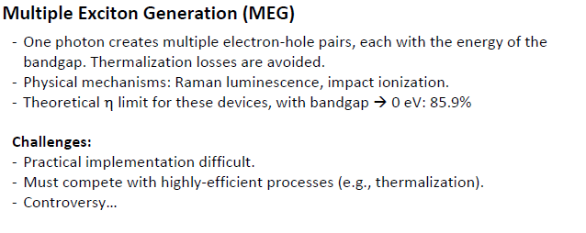
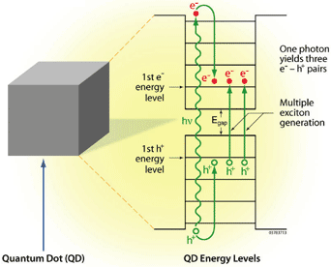
II is an Auger-type process whereby a high energy exciton, created in a semiconductor by absorbing a photon of energy 2Eg, relaxes to the band edge via energy transfer of at least 1Eg to a valence band electron, which is excited above the energy gap [Fig. 1(a)]. The result of this energy transfer process is that two excitons are formed for one absorbed photon. Thus, this process converts more of the high photon energy portion of the solar spectrum into usable energy.

Slide 25
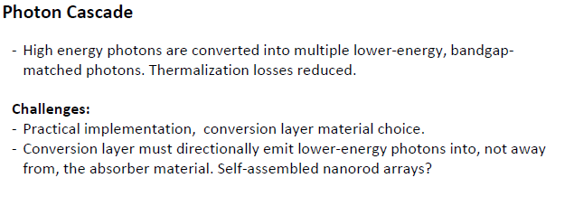

Slide 26
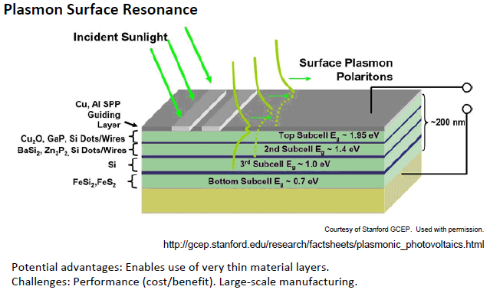
Active layers comprised of earth-abundant semiconductor absorbers (e.g. Cu₂O, Zn₃P₂, Si, β-FeSi₂, BaSi2, Fe₂O₃) and low-cost plasmonic metals (Al, Cu).

Slide 27
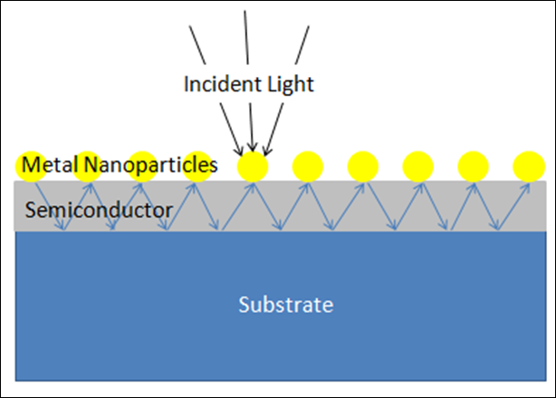
Plasmonic surface resonance
The excitation of surface plasmons by light is denoted as a surface plasmon resonance (SPR) for planar surfaces
Surface plasmons (SPs), are coherent electron oscillations that exist at the interface between any two materials

Slide 28
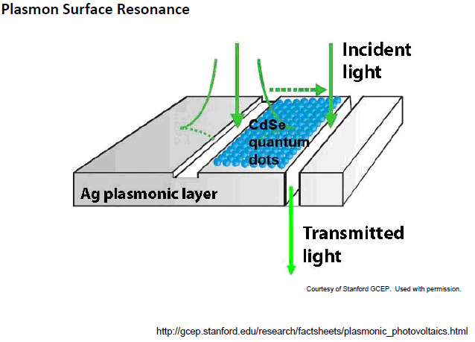
Schematic of a test bed structure consisting of a surface wave interferometer coated with CdSe quantum dots to test plasmonic light absorption. Absorption along the Ag surface is achieved through incident light conversion into surface plasmon polaritons that exhibit mode overlap with the absorber layer.

Slide 33
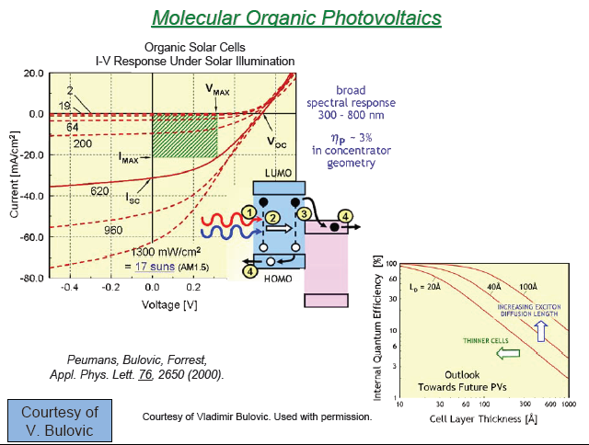

Slide 35
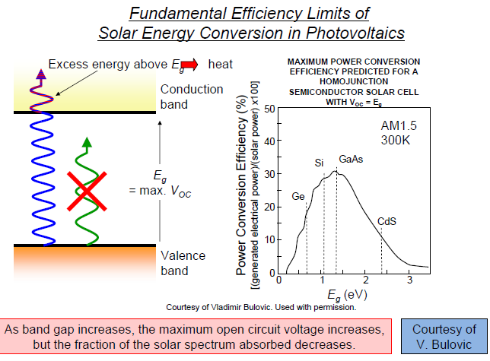

Slide 37
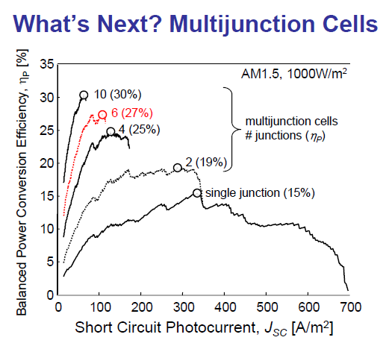

Slide 38
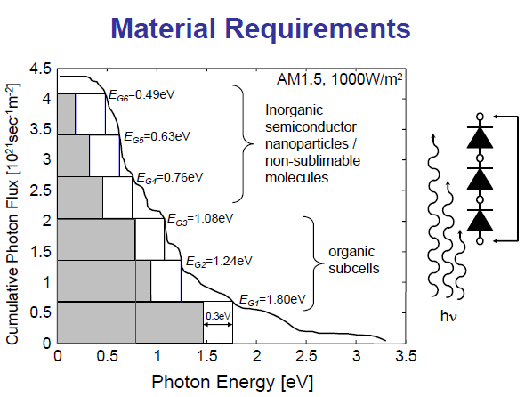

Slide 40
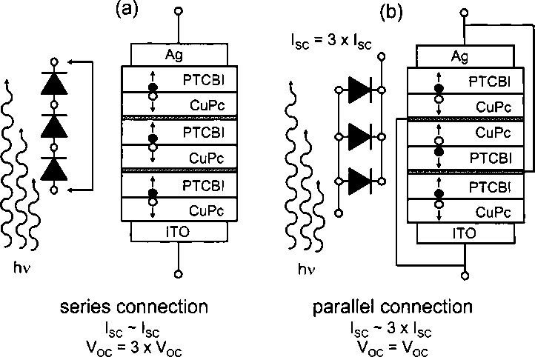

Slide 41
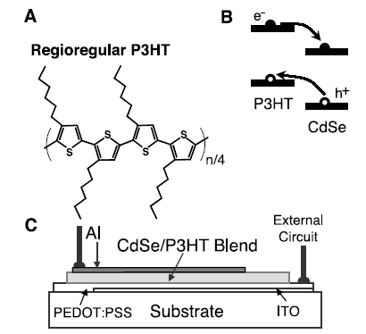
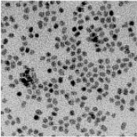
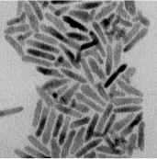

Slide 42
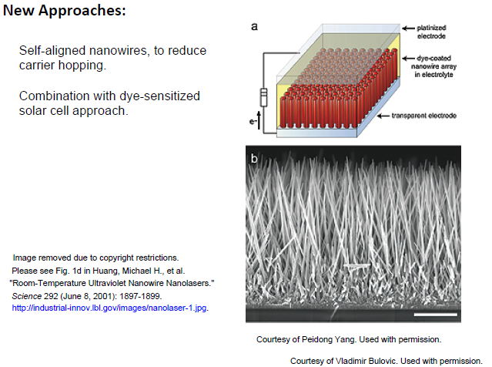
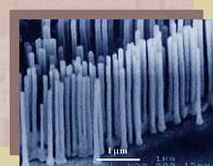

Slide 43
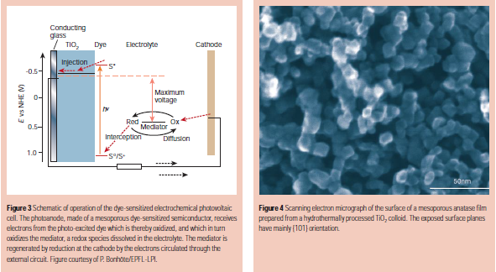

Slide 45
